Slide 1
Java Course
Shilpa Khopade

Slide 2
What is programming?
Set of instructions that tells a machine what to do
Computer understands only binary - 0 and 1
Java: 1001010 1000001 1010110 1000001
Programming
Write in a computer language – high level
Convert into machine language
Run machine language code
Translation to Machine language
Interpreted
Compiled

Slide 3
Introduction
What is Java?
Programming language
Platform
Interpreted – Byte Code
Types of Java applications
Standalone
Web
Enterprise
Mobile
Java Editions – SE, EE, ME, FX

Slide 4
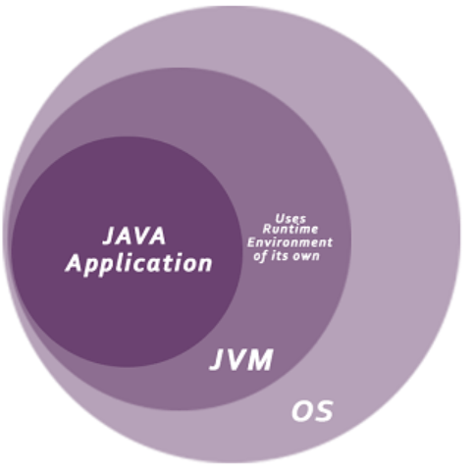
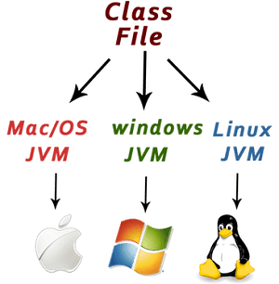
Java Virtual Machine

Slide 5
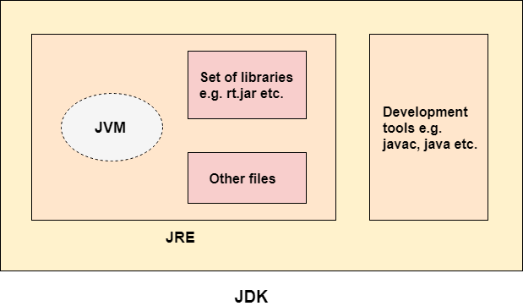
JVM, JRE and JDK

Slide 6
Exercise: Configuring the machine

Slide 7
What did we do?
Downloaded Java Development Kit, Java Runtime, Eclipse IDE
IDE – Write
JDK – Compile
JRE – Execute
Set “PATH” and “JDK_HOME”
PATH – Location of Java bin folder
JDK_HOME - Location of Java folder
Setup Eclipse
Windows->Preferences->Java->Installed JRE
Open Eclipse -> C:\EclipseWorkspace

Slide 8
Exercise: First Java program

Slide 9
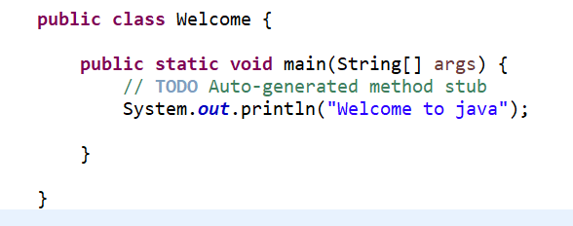
Simple Java Program

Slide 10
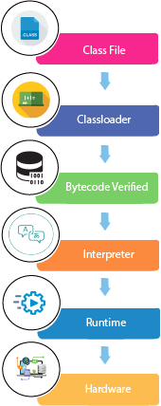
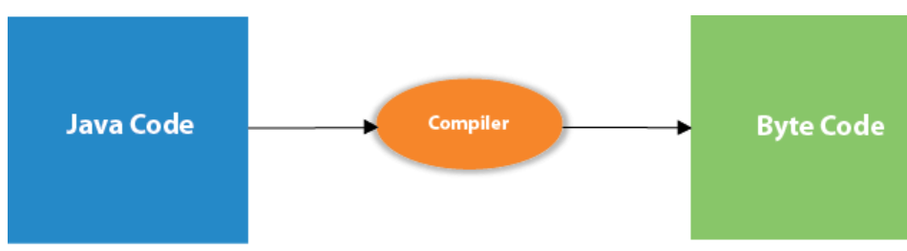
Execution of a Java program

Slide 11
Object Oriented Programming
Types of languages
Procedural
Object Oriented
Object Oriented Language
Maps the real world into programming
Easier to visualize a system

Slide 12
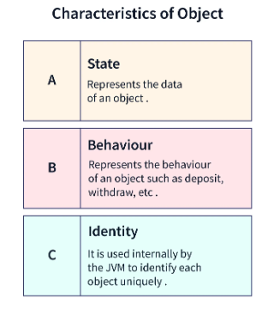
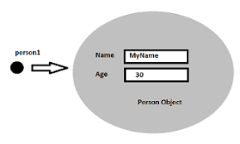
Class and Objects
Building blocks of Object Oriented Programming
Class is the definition/template of an object
Class defines state and behaviour
Object is an instance of a class
Instantiating an object of a class
Person person1 = new Person()

Slide 13
Java variables - State
Variable is a named memory location
Declaration – specify type and name
Assignment – allocate memory and provide value
Variable scope (lifetime)
Local
Instance
Static
Variable data types
Primitive
Non-primitive

Slide 14
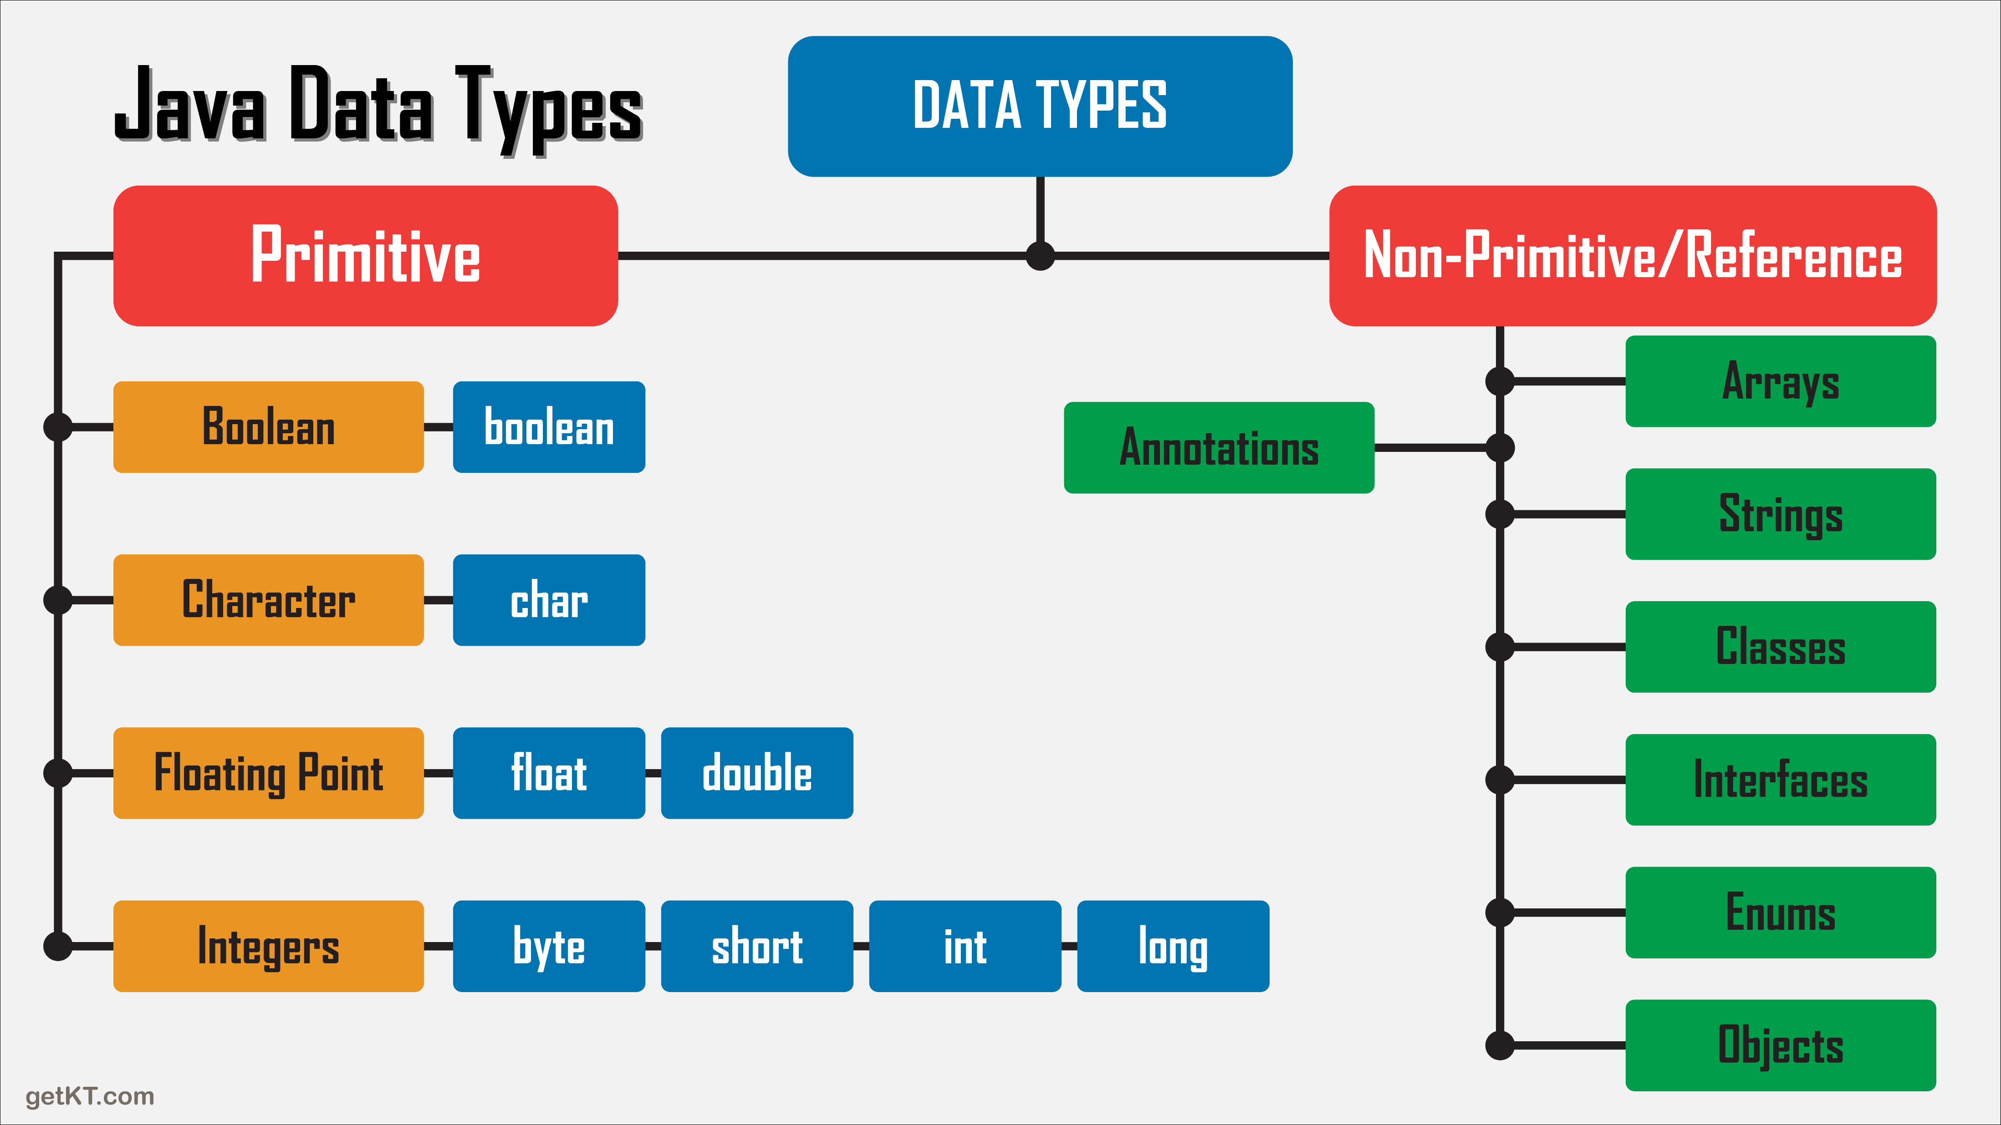
Data Types

Slide 15
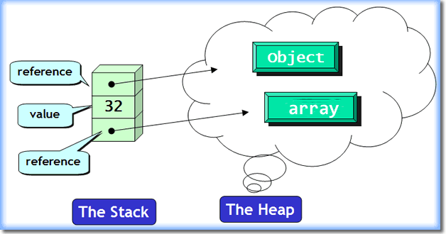
Memory allocation

Slide 16
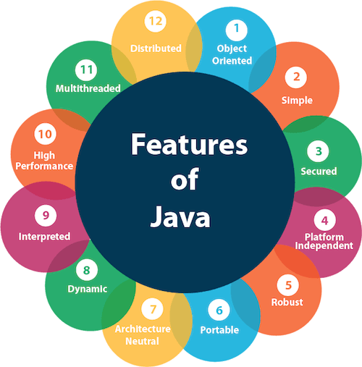

Slide 17
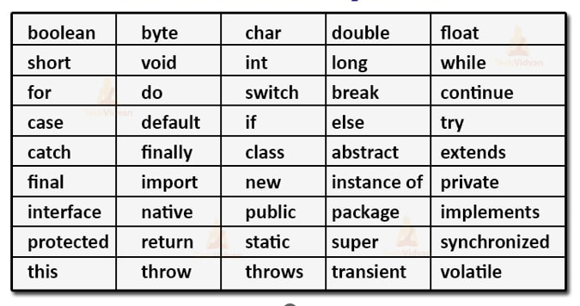
Reserved/Key words

Slide 18
Exercise: Variables

Slide 19
Operators
Unary
Arithmetic
Shift
Relational
Bitwise
Logical
Ternary
Assignment

Slide 20
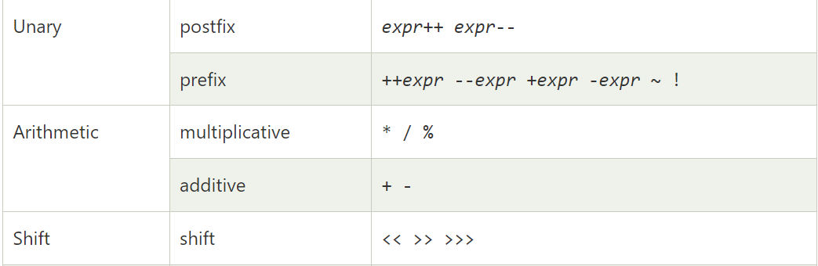
Operators

Slide 21
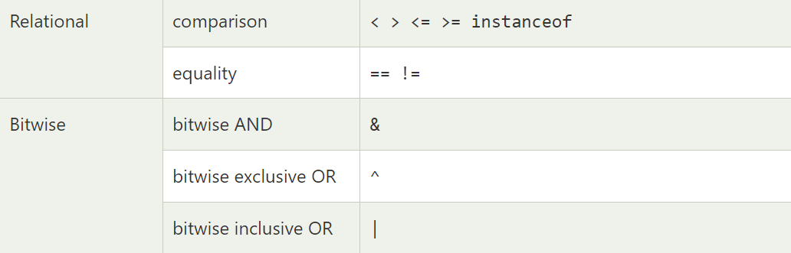
Operators

Slide 22
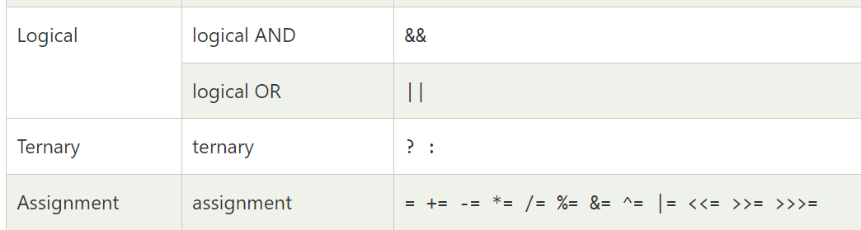
Operators

Slide 23
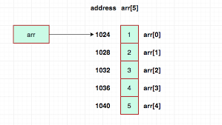
Arrays
Collection of objects/primitives of the same data-type
Fixed size
Elements can be accessed by array index which begins at 0

Slide 24
Arrays
Declaration – Name and type
Instantiation – Memory allocation
Initialization – Assigning values to each array element
Copy array

Slide 25
Methods - Behaviour
A block of code which can be “invoked”
Internally
Externally (with an object reference)
Parts of a method
Name
Parameters
Return Type

Slide 26
Methods - Behaviour
A block of code which can be “invoked”
Internally
Externally (with an object reference)
Parts of a method
Name
Parameters
Body
Return Type

Slide 27
Exercise: Methods

Slide 28
Control flow statements
Conditional
if
if-else
switch
Iterative
For
While

Slide 29
Exercise: Control flow

Slide 30
Static vs Non-Static
Static variable
Class level (e.g. Database name)
Created as soon as class is loaded
Common for all objects of the class
Static method
Called without object reference (e.g. main)
Can call only other static methods
Can access only static and local variables
Can call non-static only by object creation

Slide 31
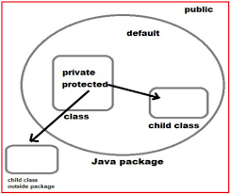
Visibility
Public
Private
Protected
Default/Package

Slide 32
Exercise: Debugging

Slide 33
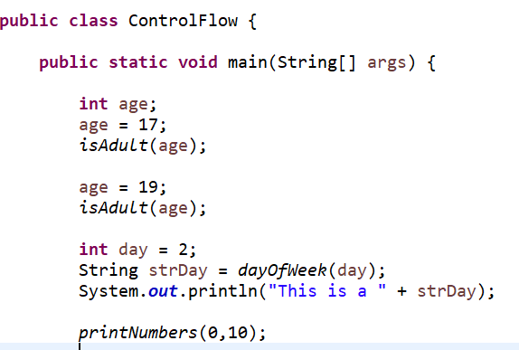
How does a Java program run?

Slide 34
Object Oriented Programming
Class – Object Template
Object – State (Has) and Behaviour (Do)
Constructors
special methods which “construct” an object - Setup
Account
State: Account Number, Account Holder Name, IBAN (static), Balance,
Behaviour: Get Balance, Credit, Debit, Generate Statement
Creation of account: Account a = new Account()

Slide 35
OOP concepts
Class Relationships
Inheritance: IS-A
Aggregation: HAS-A
Composition: CONTAINS
Abstraction
Polymorphism: Dynamic behaviour
Encapsulation: Contract

Slide 36
Aggregation vs. Composition
Aggregation:
HAS-A relationship
Weak Association
Composition:
CONTAINS relationship
Strong association

Slide 37
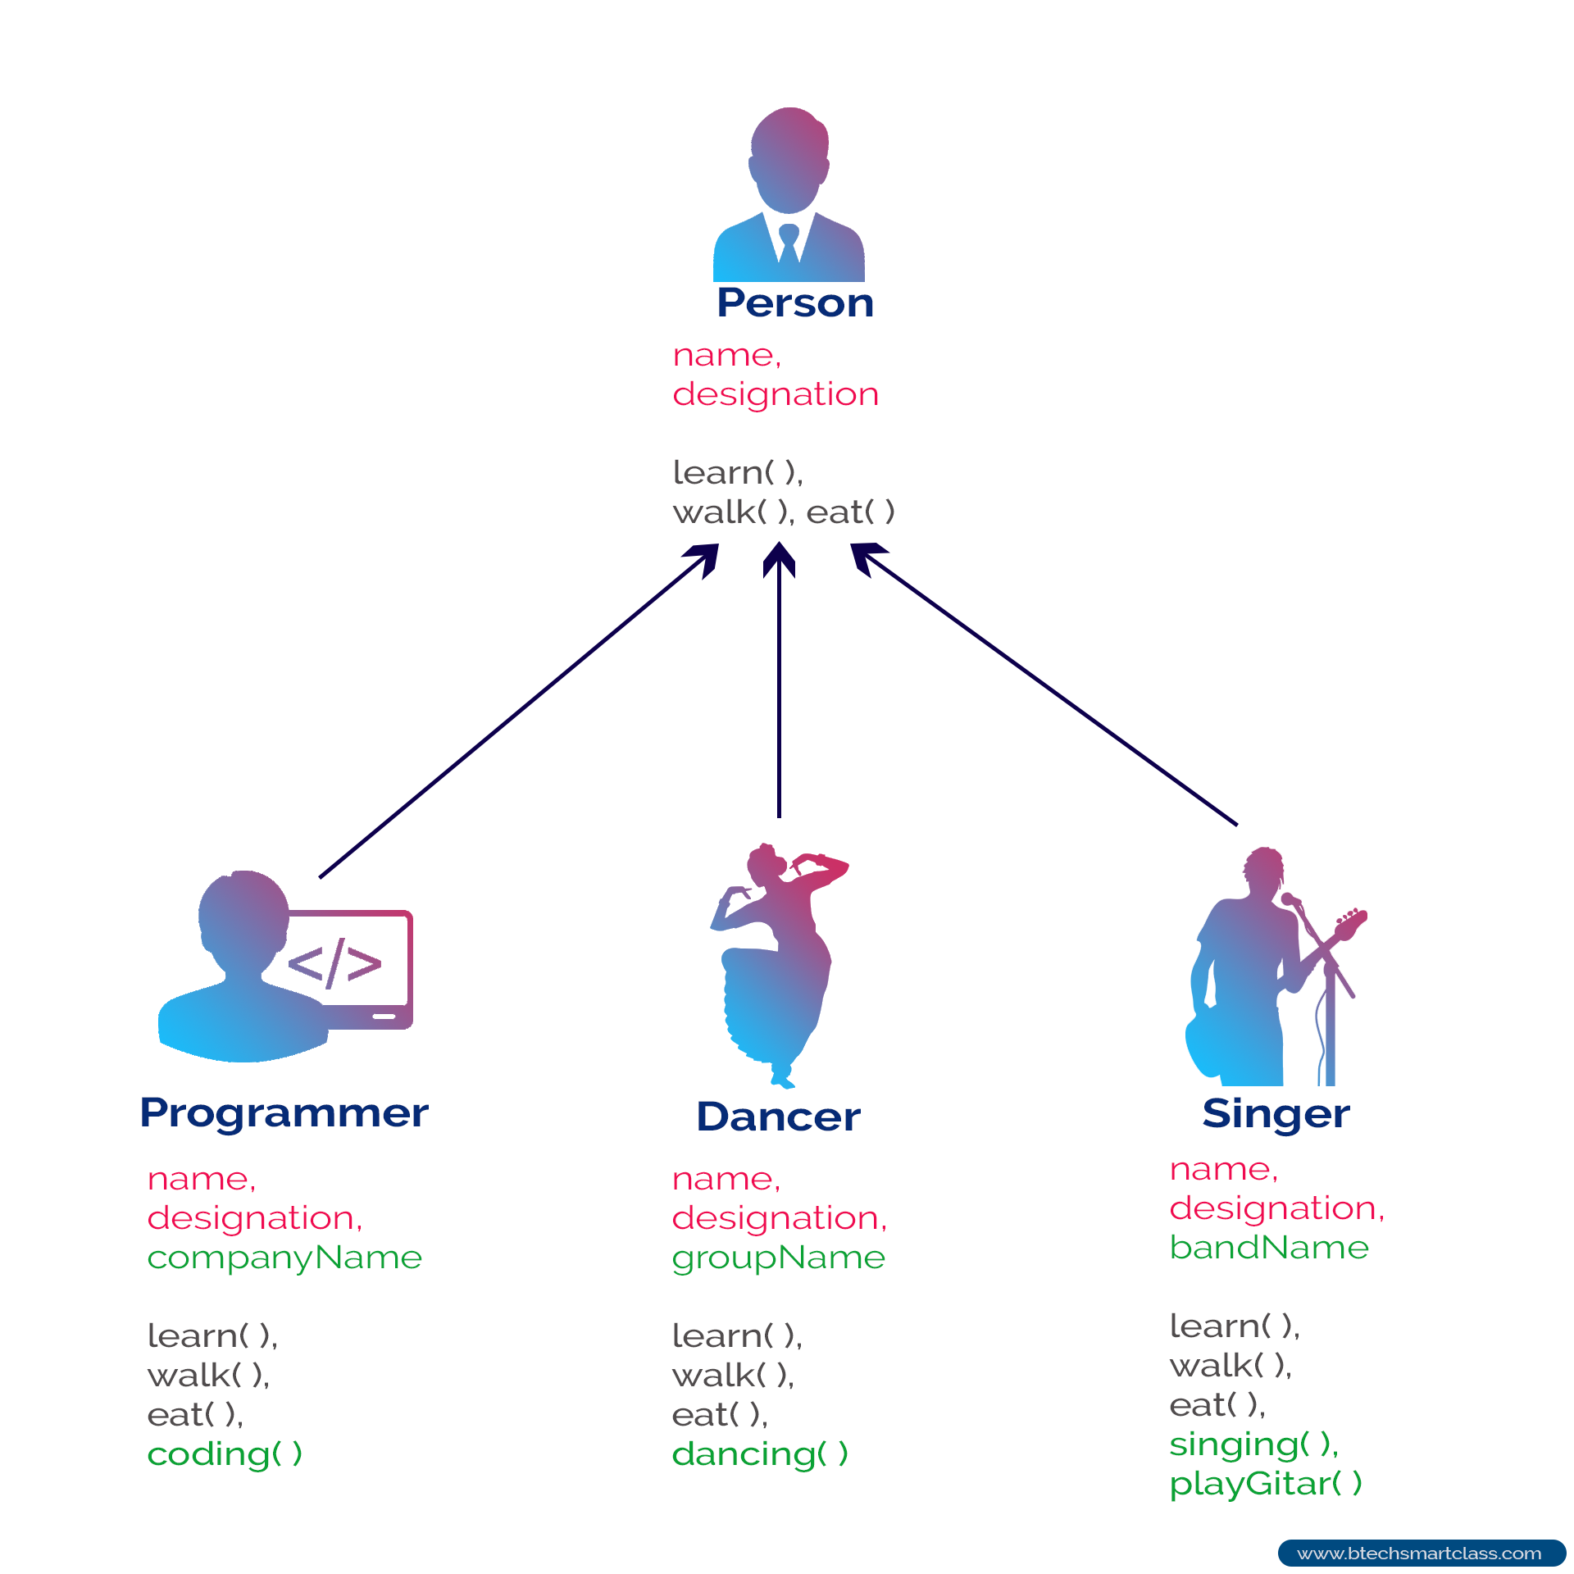
Inheritance
Sub-class/derived class/child class
Super class/Parent class
Reusability
Method overriding
Polymorphism

Slide 38
Exercise: Inheritance

Slide 39
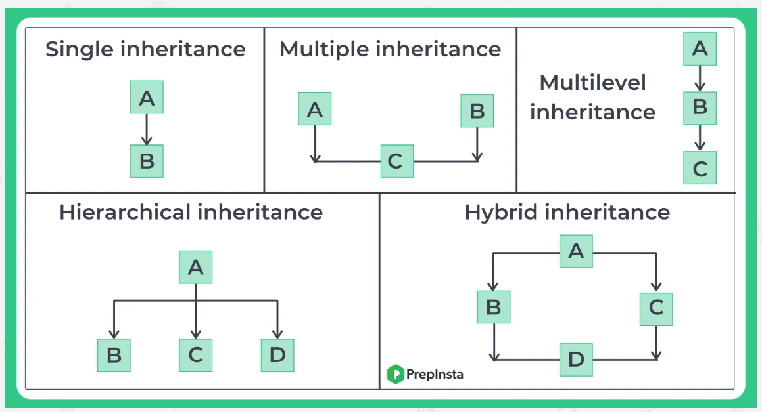
Types of inheritance

Slide 40
Constructors
Definition
Name – class name
Return type – none
Parameters - any
Types
Default constructor
No argument
Parameterized
Constructor chaining
this
super

Slide 41
Abstraction
Hiding implementation details
Exposing only functionality
Types of abstraction:
Partial: Abstract classes
Complete: Interfaces

Slide 42
Abstract classes
Part definition, part implementation
Cannot be instantiated
Child class has to:
Implement all abstract methods
OR
Declared abstract

Slide 43
Interfaces
Only definition, implementation in classes
Public and static
No constructor
Enables multiple inheritance

Slide 44
Exercise: Abstraction

Slide 45
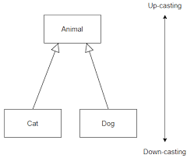
Upcasting/Down casting
Animal a = Animal() ✓
Cat c = new Cat() ✓
Animal a = new Cat() ✓
Dog d = new Animal() ☒

Slide 46
Upcasting/Down casting
Reference type checked at compile time
Object type checked at run time
Parent class reference can be used for Child class object

Slide 47
Polymorphism
One functionality, many forms
Types:
Static – Overloading
Dynamic – Overriding
Overloading – same method name, different signature
Overriding – same method name, same signature

Slide 48
Method overloading vs overriding
Super keyword
Final keyword
Parent class reference -> Child class object
Covariant Return type
Dynamic binding
Runtime polymorphism
Instanceof operator

Slide 49
Encapsulation
Package
Access Modifiers
Encapsulation

Slide 50
Exercise: OOPs

Slide 51
Collections framework

Slide 52
Generics

Slide 53
Exercise: Collections

Slide 54
JDBC

Slide 55
Exercise: Working with a database

Slide 56
Regular expressions

Slide 57
Lambda and Streams API

Slide 58
Exercise: Lambda

